Slide 1




Slide 2
Imagine a retail company that wants to analyse its sales data to understand customer behaviours.

Slide 3



The company collects data and stores it from different systems
POS System
Website Social Media
CRM System
These are known as 'Sources'

Slide 4



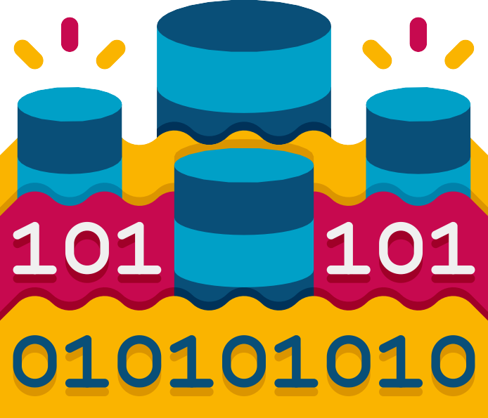
For analysis, they would like to collect and store all this data at one place.
Data Warehouse
Data Lake
These are known as 'Destinations'

Slide 5



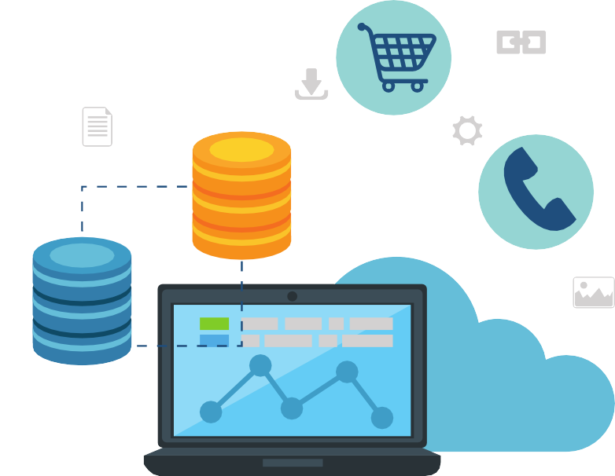

How will they build the connection?
How do I move the data?
Destination
Source

Slide 6



Data Pipeline
A data pipeline is a series of automated processes that move data from one system or stage to another.
Destination
Source

Slide 7
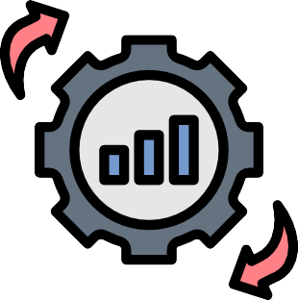
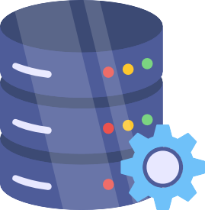

The processes in a data pipeline can include
Extraction
Validation
Transformation
Loading
Quality Checks
Monitoring

Slide 8

Without a data pipeline,
The company will have to manually transfer data, perform multiple extracts and transformations on the same data, which makes it difficult to track changes, and becomes time- consuming leading to poor data quality and insights.

Slide 9






With data pipelines, they can
Automate data flows
Have flexible integration
Be cost-effective Produce better insights
Maintain data consistency

Slide 10






Common types of data pipeline
Batch Data Pipeline:
Processes data in large chunks At specific intervals.
Used for non-time-sensitive data
Streaming Data Pipeline: Processes data in real-time Commonly used for time- sensitive data
financial transactions social media feeds.

Slide 11

ETL Pipeline:
Extracts data from various sources
Transforms it
Loads it into the destination system.
ELT Pipeline:
Extracts data from various sources
Loads it into a destination system
Transforms it

Slide 12
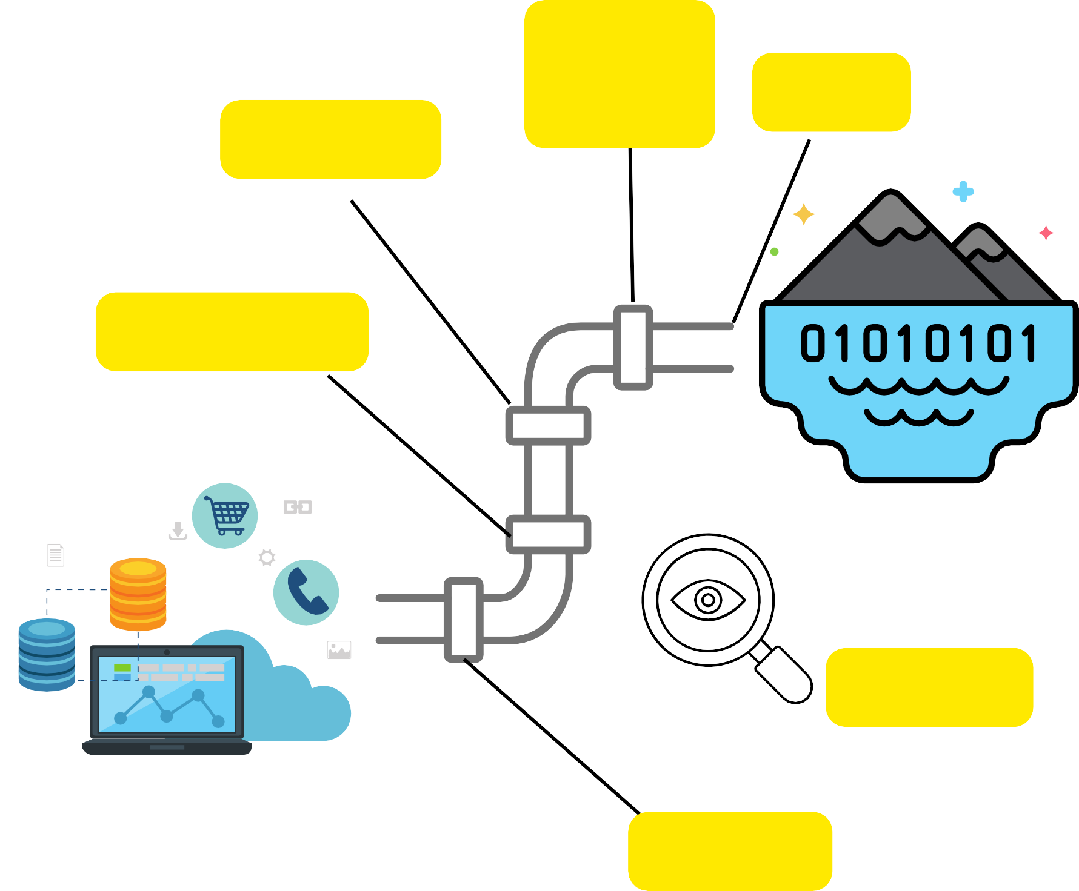

Data pipelines are an efficient means for managing and processing data enabling automation, improved governance, and providing accurate insights to inform decision-making.
Quality Check
Load
Validate
Transform
Destination
Monitor
Source
Extract

Slide 13

RESOURCES
Data Pipeline | IBM
Design a data pipeline Build a data pipeline | GCP
Build a data pipeline | Azure
Build a data pipeline | AWS
Click them to find out more!

